Slide 1

TITLE OF THE PROJECT
TOIL SERVICES
FINAL WEB DEVELOPMENT
REPORT
by
GROUP-1
NAME OF CANDIDATES
NAME: ANURAG MISHRA-11708395
NAME: ABHISHEK HATWAR-11716550
NAME: ASHUTOSH KHAJURIA-11712194
NAME: AMAN SRIVASTAVA-11715962
Section: K17MD

Slide 2
Features of my Toil Services website :
Project Description:
A beautiful and motivative user interface
Information about the site.
Registration form for users.
The Project Toil.com is a website which deals with the problems faced by every common man.
The website deals with many servicing avenues such as Pluming, Carpentry, Electric, Pest control, House Projects etc.

Slide 3
Work Division:
Candidate 1: ANURAG MISHRA
Designing of user interface
Creation of whole home page
Header-footer for all the pages
A Tutor page where user can view detailed of video lectures.
Candidate 2: ABHISHEK HATWAR
Designing of user interface
Creation of whole home page
Header-footer for all the pages
A Tutor page where user can view detailed of video lectures.
Candidate 3: ASHUTOSH KHAJURIA
Designing of user interface
Creation of whole home page
Header-footer for all the pages
A Tutor page where user can view detailed of video lectures.
Candidate 4: AMAN SRIVASTAV
Designing of user interface
Creation of whole home page
Header-footer for all the pages
A Tutor page where user can view detailed of video lectures.

Slide 4
Technologies Used:
Generally five types of technologies are used-
Hypertext Mark-up language [HTML]
Cascading Style Sheets [CSS]
JavaScript [ JS]
Angularjs
Bootstrap

Slide 5
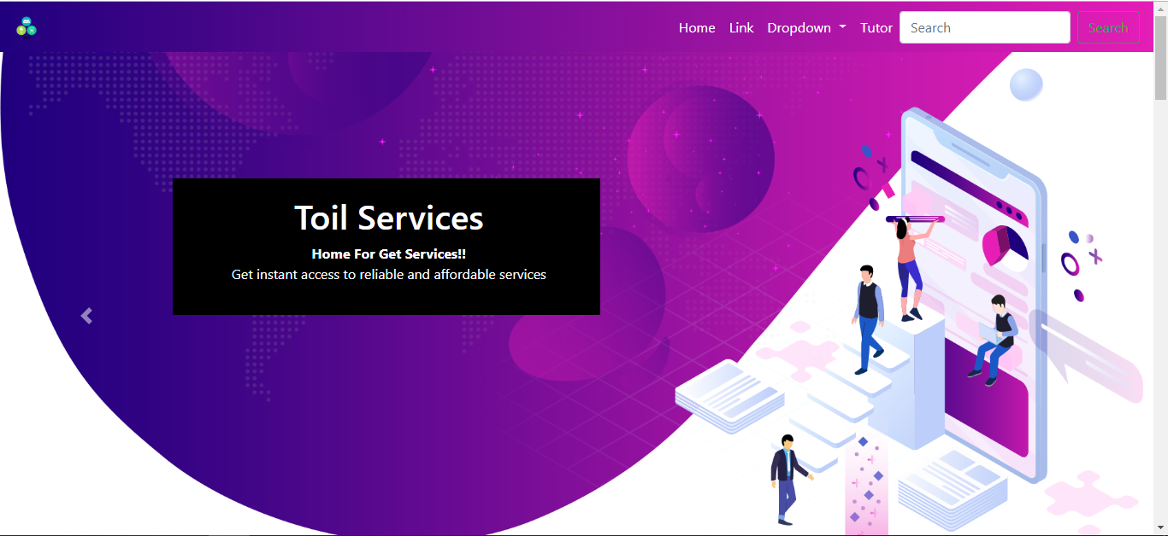
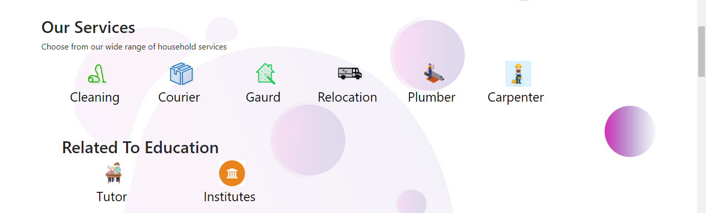
Candidate 1 Anurag Mishra-

Slide 6
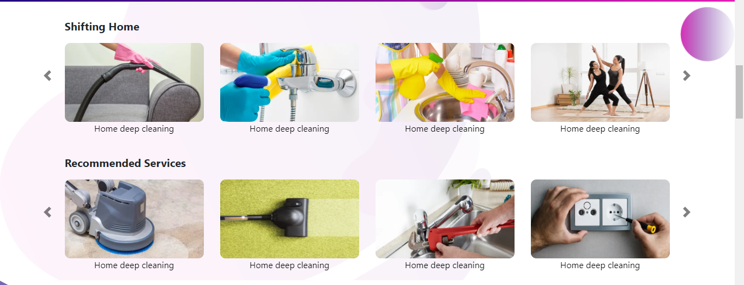
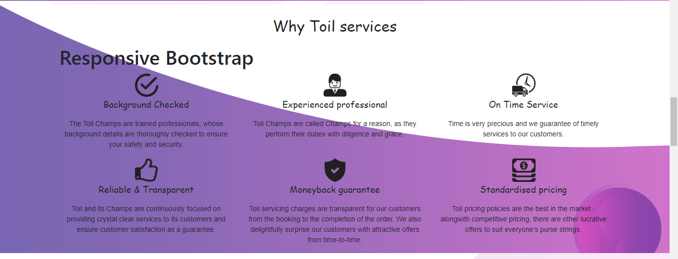
CANDIDATE 1-ANURAG

Slide 7


Home Page Details

Slide 8
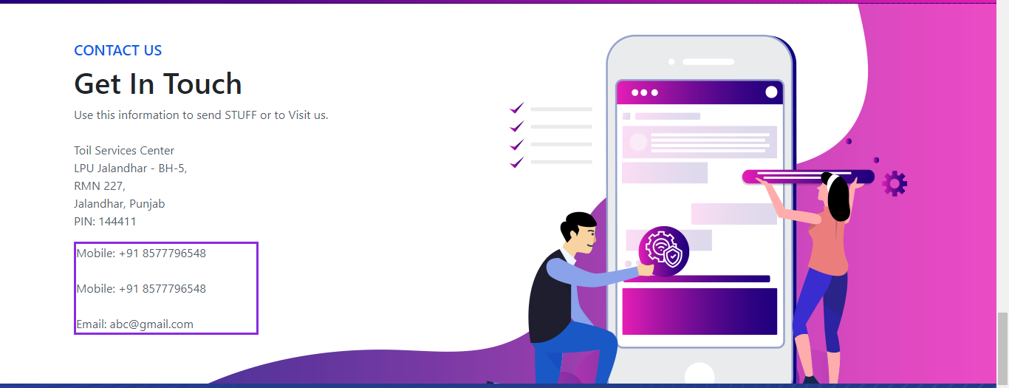
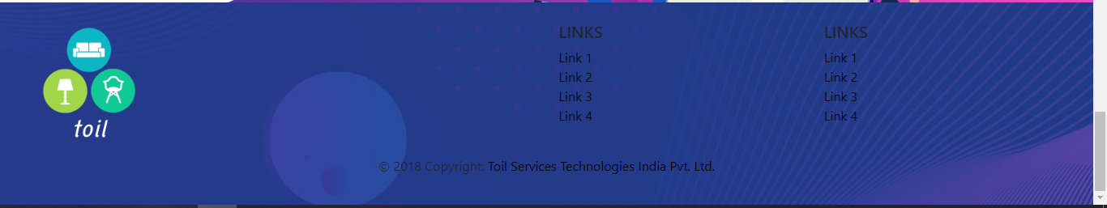
Get In Touch:
Footer:

Slide 9
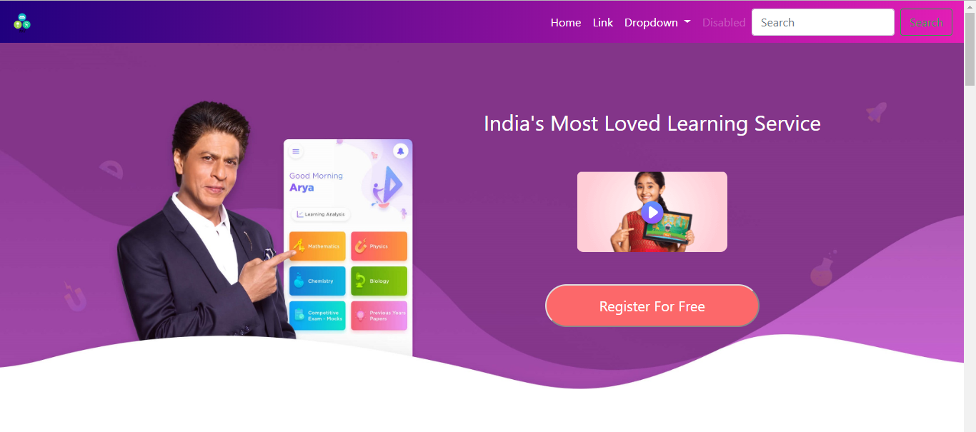
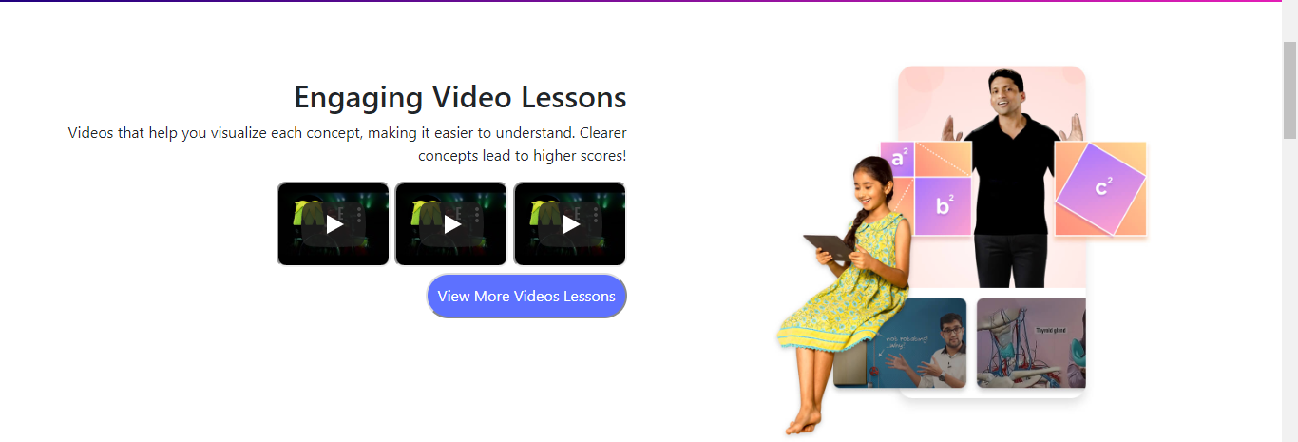
For New User

Slide 10
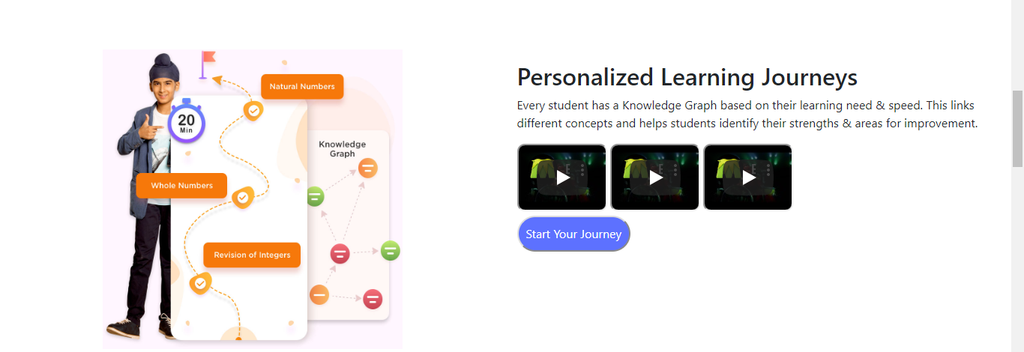
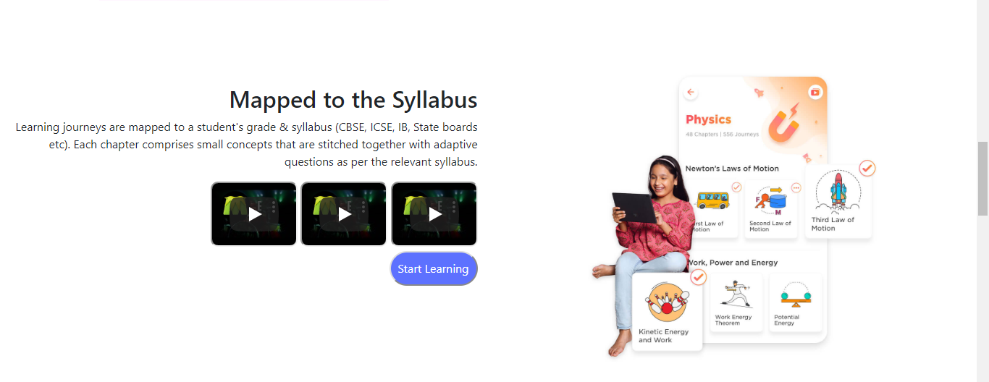
Contact us Page

Slide 11
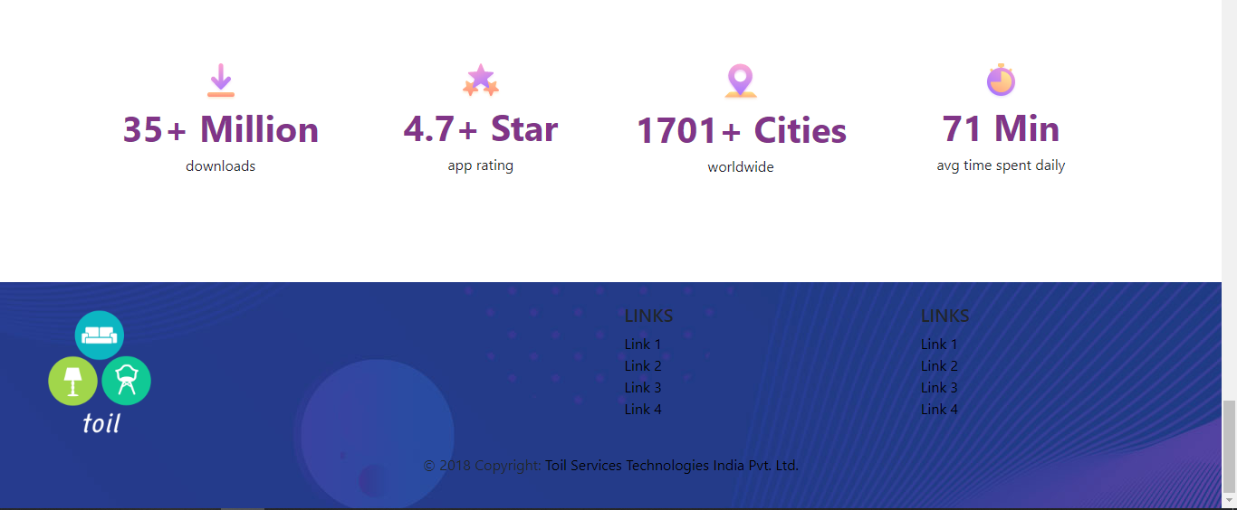

Slide 12
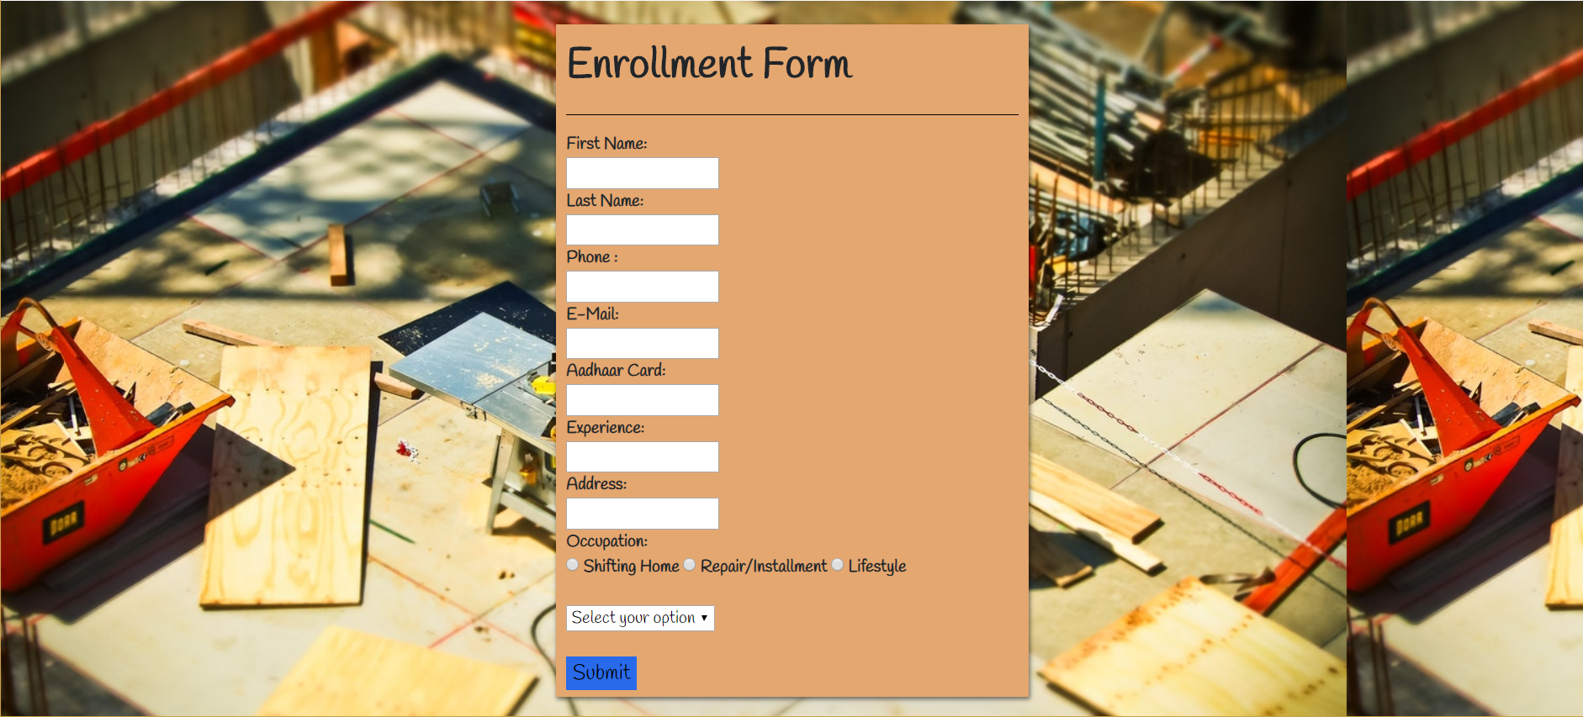
CANDIDATE 2- Abhishek hatwar

Slide 13
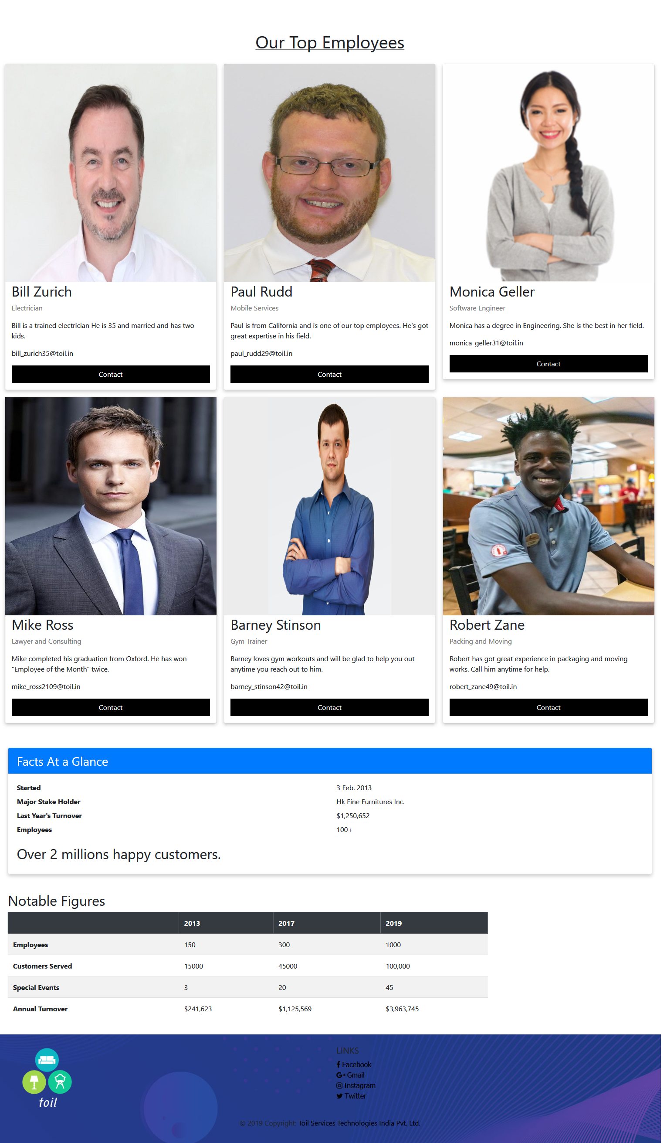
Candidate 3: Aman Srivastava

Slide 14
Thank you

